Slide 1
AIDS PREVALENCE DATA ANALYSIS PROJECT
INTRODUCTION
This is TASO Data Analysis Program
Implemented By TASO Administrators
Data presentation is in Visualized format
Visualizations include graphs, Pie-charts etc
Built using R in RStudio, a popular statistical programming language

Slide 2
PROBLEM STATEMENT
Insufficient planning for people living with AIDS in Uganda
Inaccurate statistical prediction of Aids Data Prevalence due to denial of young people access to AIDS prevention methods and statistical data have been distorted through the inaccurate extrapolation of data from small urban clinics to the entire population.

Slide 3
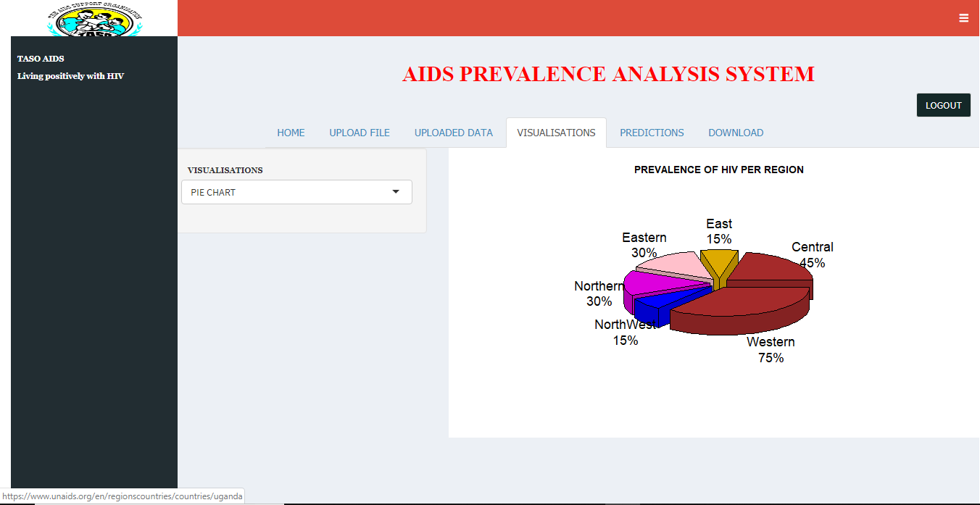

Slide 4
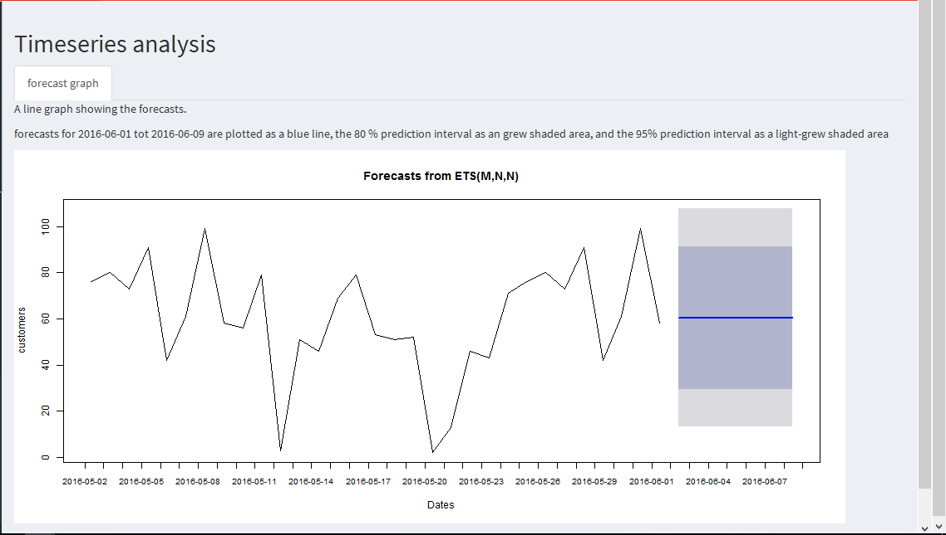

Slide 5
Conclusion
The major aim of designing THE AIDS PREVALENCE DATA ANALYSIS SYSTEM was to provide an automated and improved solution to TASO that would analyze all field collected data. The results of the analysis would be handed over to TASO by the operation staff to the overall executives who in return provide better services compared to the earlier service.

